Slide 1
Adversarial Examples with Explainability
in Medical Imaging
Bartosz Schatton
b.schatton@gmail.com
Notes:
Hi everyone and thank you for joining today.
My name is Bartosz and I am an MSc student working with Katya on my thesis this year.
The full title of my thesis is “Informed Adversarial Attacks with Explainable AI and Metaheuristics in Medical Imaging”

Slide 2
Structure
Introduction
Medical Imaging
Adversarial Examples
Explainability
Adversarial Examples and Explainability
Demo
Review
Further Research
Questions
Notes:
My research very wide, or interdisciplinary in nature. I am going to talk about a number of different topics to hopefully give everyone the understanding required to grasp the idea I am presenting.
But please do interrupt if you think anything could be clarified or added.
Introduction – motivation. hypothesis we are working with and the objective of todays session
Medical imaging – what it is, what are the characteristics
Adversarial examples, adversarial attacks, defences and robustness
Explainability or Explainable AI – why is it important, what are the different techniques
Merge these two topics
Before we move on to a quick demo
We are going to review the results
Lay out further research questions
End the session with a bit of Q&A

Slide 3
Introduction
Motivation
Increasing adaptation of AI systems in medical domain
Systemic lack of trust in AI in the industry
High vulnerability to adversarial attacks
High risk associated with the misbehaviour of AI systems
Lack of related research
Notes:
My research motivation came from seeing the bulk of the related research conducted on topics such as autonomous driving and general purpose image classification problems. We have examples of digit and sign recognition. We examples of face recognition. But not much about medical domain.
Lack of trust in AI in medical domain through lack of transparency and general hesitation towards replacing experts with automated systems.
Autonomous Driving and how severe the outcomes of a misbehaved systems are, i.e. a fatal accident.
We don’t hear nearly as much about medical applications, in fact the research on the vulnerabilities of AI in medical domain is very limited

Slide 4
Introduction
Hypothesis
Explanations can inform adversarial attacks
Objective
Demonstrate that the use of Explainable AI can help in generation of Adversarial Attacks in a black-box non-targeted scenario in a Medical Imaging domain.

Slide 5
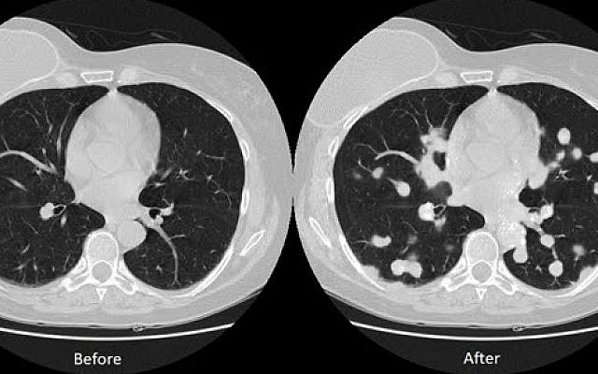
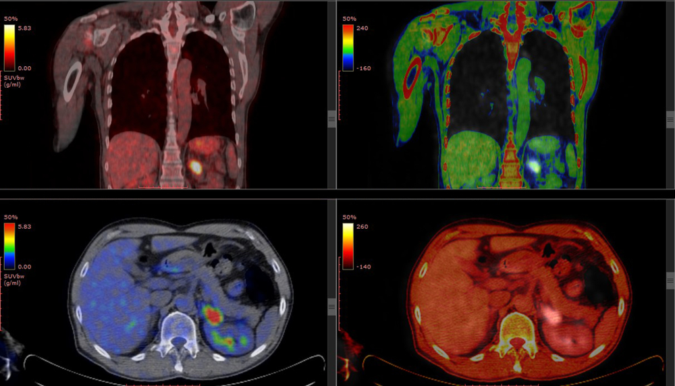
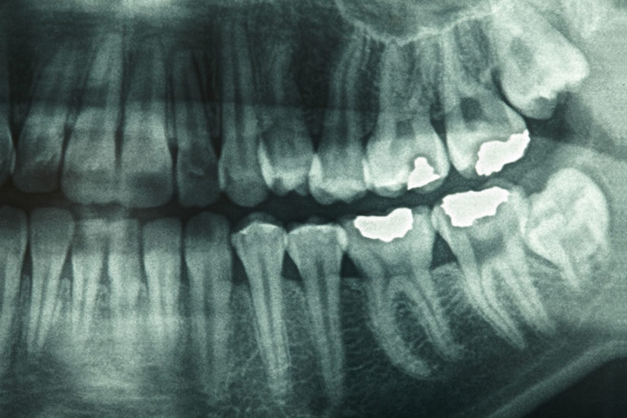
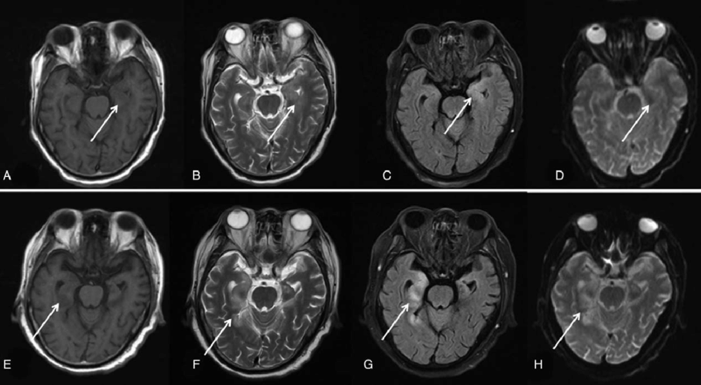
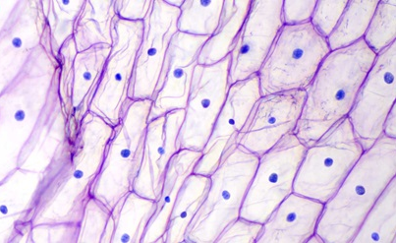
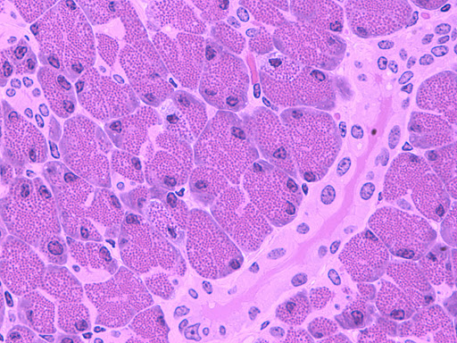
Medical Imaging
Sources
X-Rays
Ultrasounds
Computed Tomography (CT)
Positron Emission Tomography (PET)
Magnetic Resonance Imaging (MRI)
Histology (tissues)
Cytology (cells)
Dermoscopy
Applications
Classification
Detection
Localisation
Segmentation
Notes:
Types of images:
In most cases the images can be both 2 and 3-dimentionals
Among applications of medical imaging we can denote:
Classification (binary and multi-class)
Detection (identifying bounding boxes around objects of difference classes)
Localisation (identifying objects of specific class with a bounding box)
Segmentation (identifying outlines of objects)
The appropriate type of task is dictated by the type of imagery and expected output, for example a clinician looking to detect a tumour through a CT scan would most likely be expecting to see the localisation that separates its out from the healthy tissue, in contrast to classiﬁcation which could conﬁrm presence of blood in an MRI brain scan. Segmentation, on the other hand, would come useful in recognising the positions of large anatomical structures for educational purposes.
Among use cases we can talk examples such as lung cancer grading, tumor detection and characterisation, gene profiling and blood cell composition, which is what my research focuses on.

Slide 6
Medical Imaging
Characteristics
High quality and resolution
Highly specific inputs
Highly specific outputs
Captured in a controlled environment
Poor availability
Limited in size
Notes:
Similar structure, tonality
Relatively small areas of interest

Slide 7
Medical Imaging
White Blood Cell Classification
Referred to as Differential Counting
Allows to assess patients overall health, intensity of auto-immune responses and diagnosis of specific health conditions such as leukemia
Classifies white blood cells from blood smears
Research relates to image pre-processing, feature engineering and model design
Source: BCCD Dataset https://github.com/Shenggan/BCCD_Dataset
Notes:
Blood disorders – leukemia, anemia, lymphoma
Image processing, feature engineering.
-extracting the white cell from the background
-removing background
-extracting various features, resizing etc
With the advancements of Convolutional Neural Networks we can move away from those laborious techniques
The majority of identiﬁed papers on white blood cell classiﬁcation focus heavily on image processing, such as that of Su et al. (2013) who divide the process into three stages: (1) separating cells from their background, (2) feature engineering, and (3) model design. The suggestion there is that the performance of white blood cell classifying models is closely related to the ability to process the input images, more speciﬁcally to separate the leukocytes from their backgrounds.

Slide 8
Medical Imaging
White Blood Cell Classification
https://www.cellavision.com/
Notes:
CallaVision uses convolutional neural networks

Slide 9
Explainability
Explainable AI
Explainable AI refers to methods and tools that provide an explanation to model’s decision that is interpretable by the recipient, i.e. a patient, clinician, researcher or a health organisation.
There is typically a trade off between model Explainability and its Performance
Notes:
Typically, there is a trade-oﬀ to be made between model explainability and its performance.
In fact, often the most accurate models, such as deep neural networks, provide the least transparency and interpretability, while the ones that provide clear explanations, such as linear models and decision trees, are the worse performers.
At the moment humans still participate in the creation of the models and therefore at the very least it gives us a level of understanding of how the model is designed and how it is expected to work.
Ultimately, a truly intelligent system will be able to generalise the latent properties of the training data to the extent where any form of human interaction or feature engineering will become redundant, thus explainability is the key to building trust placed in such systems.

Slide 10
Explainability
Explainable AI
ante-hoc
built into the systems they explain
post-hoc
built to provide local explanations of specific instances

Slide 11
Explainability
Explainable AI
black-box
use model’s miracle response to approximate predictions with an interpretable surrogate function
white-box
rebuild the model with explanations built-in
create a saliency map
Notes:
Create a saliency map topographical representation of the inputs

Slide 12
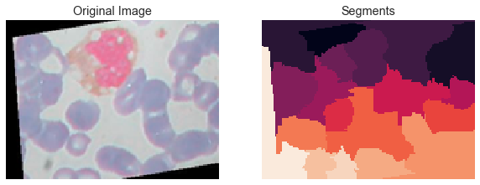
Explainability
Lime
Python library
An example of a post-hoc black-box XAI system
Stands for local interpretable model-agnostic explanations
Can be used to interpret text and image classifiers
Segments the input and applies a simple linear classifier based on model’s miracle response
Can return regions and attributed positively and negatively to a particular output class
Notes:
Segments > super-pixels
The colours in the segmentation here does not mean anything, it just refers to the index of the segment
Figure 2.6 shows an example output highlighting the contributing areas and the underlying image segmentation. In this case the model was trained to categorise a white blood cell into one of the 4 categories.
The provided output, is not particularly useful in explaining the prediction, other than pointing out the location of the white blood cell – we still have no idea why this particular cell was categorised as a speciﬁc type of leukocyte, although it does point out the fact that the model seem to be focusing on the right areas of the image, thus somewhat validating its overall design.
Another important drawback of LIME is its high computational complexity particularly visible in high performing and complex Deep Leaning models

Slide 13
Explainability
Lime
We can select as many top features as required
Negative areas can be switched on and off
Generally it is simple to use
It is probably the most documented and experimented with XAI system at the moment

Slide 14
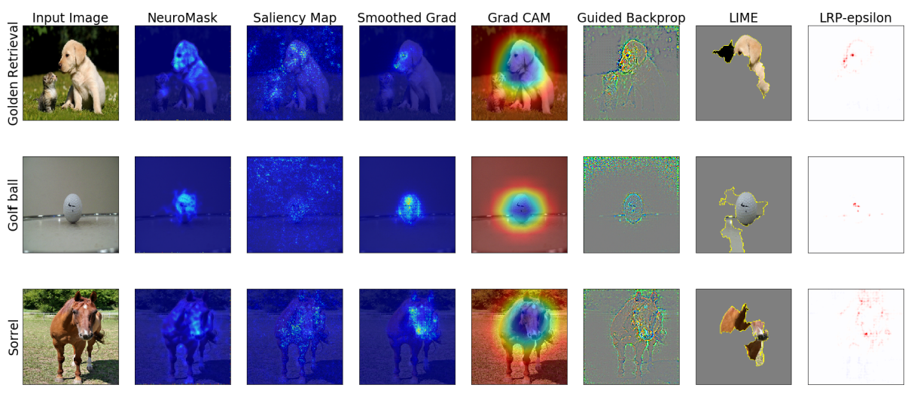
Explainability
Explainable AI
Notes:
Here we can see multiple examples of Explainable AI systems and their explanations given for sample images.
I am keen particularly on NeuroMask but there is not much documentation available as it is quite a new idea.

Slide 15
Adversarial Examples
Definition
Adversarial Examples expose model’s “blind spots” and latent properties, and are used to determine its robustness and improve defences against “adversarial attacks”.
Assuming instance x is classiﬁed correctly by classiﬁer f returning a single outcome class, we observe an adversarial example x0 when it is missclassiﬁed and close to instance x under a particular distance metric D, formally:

Slide 16
Adversarial Examples
Characteristics
Transferability - adversarial attacks on one model will work on another model that has been trained to perform the same task
Regularisation eﬀect - the model will improve its robustness against adversarial attack if it is trained using adversarial examples
Adversarial instability - physical manipulation of adversarial examples, such as rotation, typically invalidates them
Notes:
Adversarial attacks often exploit the transferability characteristics of adversarial examples by training a surrogate model to perform the same task, thus eﬀectively reverseengineering the targeted model. This opens up a wide array of potential ways of constructing adversarial attacks in what essentially is a white-box scenario and then attacking the target model with created instances.

Slide 17
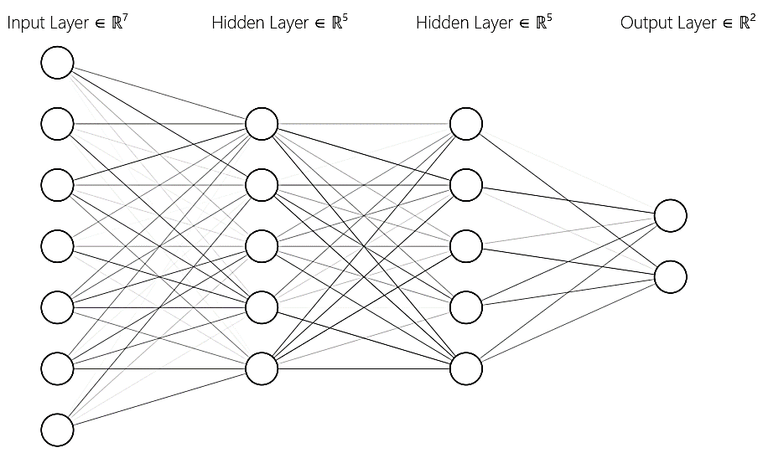
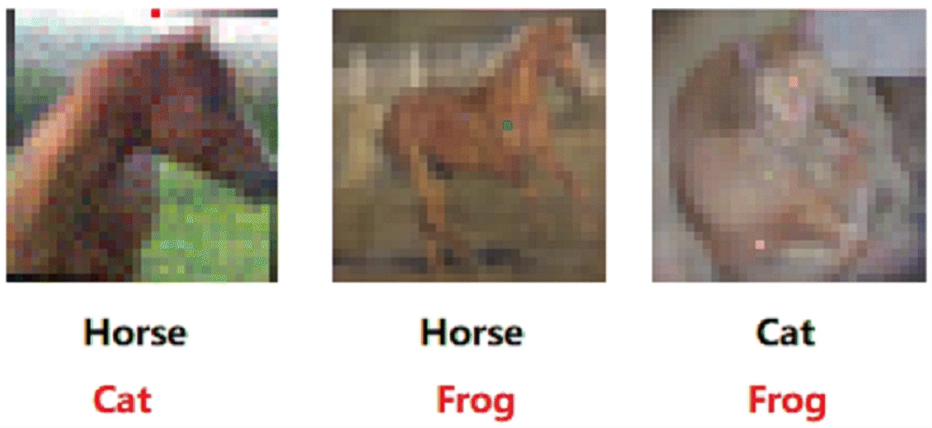
Adversarial Examples
Types of Adversarial Attacks
Black Box
Access only to Miracle Response →
White Box
Full Access to Model Structure →
NEUTROPHIL | EOSINOPHIL | MONOCYTE | LYMPHOCYTE
0.00000 | 0.00683 | 0.00000 | 0.99317
Source: https://arxiv.org/pdf/1810.11580.pdf
Notes:
Adversarial attacks are typically categorised based on the attacker’s access to model information into black-box and white-box scenarios.
In black-box attacks the attacker has no knowledge about the model’s structure, weights and biases though an attack is still possible and is on a so called miracle reaction where the model response contains set of probabilities P for each corresponding output class.
On the other hand, in a white-box scenario the attacker has full access to the model structure therefore a successful attack can be created in a number of ways – for example using a gradient or a saliency based approach.

Slide 18
Adversarial Examples
Objectives
Targeted Attack
Misclassify instance as a particular class,
i.e. a particular instance classified as a stop sign
Non-Targeted Attacks
Misclassify instance as any other class,
i.e. stop sign classified as anything but a stop sign
Confidence Reduction
Reduce the classification confidence,
i.e. stop sign classification reduction from 0.99
Source/Target Misclassification
Re-map the classification from particular target output to another output,
i.e. stop signs classified as give way signs
Notes:
.

Slide 19
Adversarial Examples
Robustness
Typically reported as a measure of accuracy under an adversarial attack scenario.
Adversarial Defences
Adversarial Detection
Increasing the size of Training Data
Image Augmentation
Stochastic Transformation
Generation of Adversarial Examples
Notes:
Generation of Adversarial Examples: there is evidence that the larger the training set, the more robust a Convolutional Neural Network tends to be. Indeed, the commonly applied defence against adversarial examples is to increase the training dataset by generating additional training instances.
Stochastic transformation: i.e. gaussian noise or randomised discretisation
Generation of Adversarial examples: widely adopted though laborious and computationally expensive
In medical imaging the research is very limited. It was reported in a paper 2 years ago that the impact of adversarial examples in medical imaging remains unknown.
There is one paper that shows on quite a high level the adversarial vulnerabilities of Convolutional Neural Networks in segmentation of MRI scans and skin lesion classification problems.
They demonstrate the adversarial vulnerabilities of Convolutional Neural Networks in segmentation of MRI scans and skin lesion classiﬁcation problems, apply several methodologies to craft nontargeted white-box attacks with the aim of assessing adversarial robustness and suggest that the depth of the segmentation models increased the robustness against adversarial examples. At the same time they show that the tested models were robust against Gaussian noise, while not robust against malicious attacks.
There is a little bit more about adversarial training in medical imaging domain. One paper that I found demonstrated that adversarial training increases the performance of MRI segmentation model however their research was not aimed to assess robustness under an adversarial setting.

Slide 20
Adversarial Examples and Explainability
HIDDEN PROPERTIES
Notes:
The way that I like to look at these things is, to consider the hidden properties of a complex Convolutional Neural Network

Slide 21
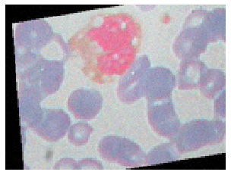
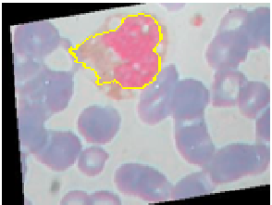
Adversarial Examples and Explainability
EXPLOIT ←
HIDDEN PROPERTIES
→ EXPLAIN
Notes:
Or explain them to validate and understand the model behaviour
In fact the relationship between Adversarial Examples and Explainability is more than just intuitive.

Slide 22
Adversarial Examples and Explainability
Experimental Evidence
Use of Explainability to detect Adversarial Attacks
“Attacks Meet Interpretability: Attribute-steered Detection of Adversarial Samples” https://arxiv.org/abs/1810.11580
Adversarial Examples used as Explanations
“Adversarial Explanations for Understanding Image Classification Decisions and Improved Neural Network Robustness” https://arxiv.org/abs/1906.02896
“Why the Failure? How Adversarial Examples Can Provide Insights for Interpretable Machine Learning” https://dais-ita.org/sites/default/files/2374_paper.pdf
Computing Adversarial Examples from Explanations and vice-versa
“On Relating Explanations and Adversarial Examples” https://papers.nips.cc/paper/9717-on-relating-explanations-and-adversarial-examples.pdf
Notes:
We have some experimental evidence that suggests that the relationship exists and what’s more can be used both ways.

Slide 23
Adversarial Examples and Explainability
Theory
Set Duality
Source: https://papers.nips.cc/paper/9717-on-relating-explanations-and-adversarial-examples.pdf
Notes:
Here we have an example from a paper “On Relating Explanations and Adversarial Examples”
By listing all minimal counterexamples, we can extract all minimal explanations and vice-versa
XP: Explanation
CE: Counterexample (classified incorrectly)
AE: Adversarial Example (classified as 6)
Here in c), the explanation is the Blue pixel. If we set it to black, while the gray pixels are any colour the prediction will still remain the same

Slide 24
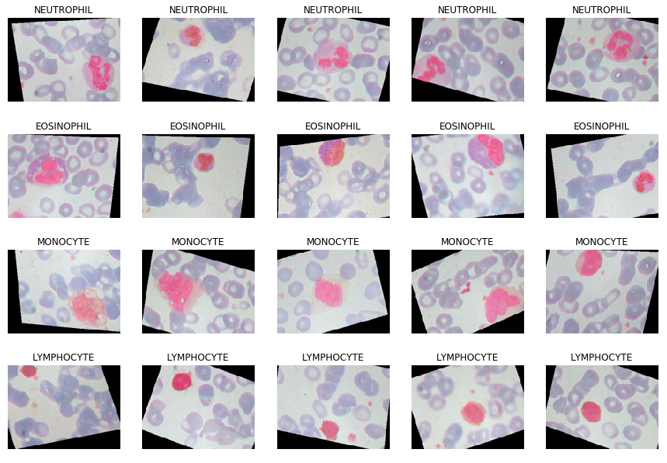
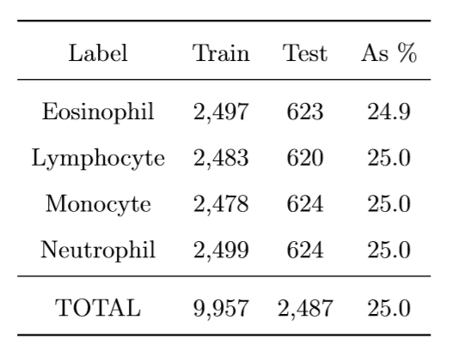
Demo
Data
Augmented BCCD Dataset
https://www.kaggle.com/paultimothymooney/blood-cells

Slide 25
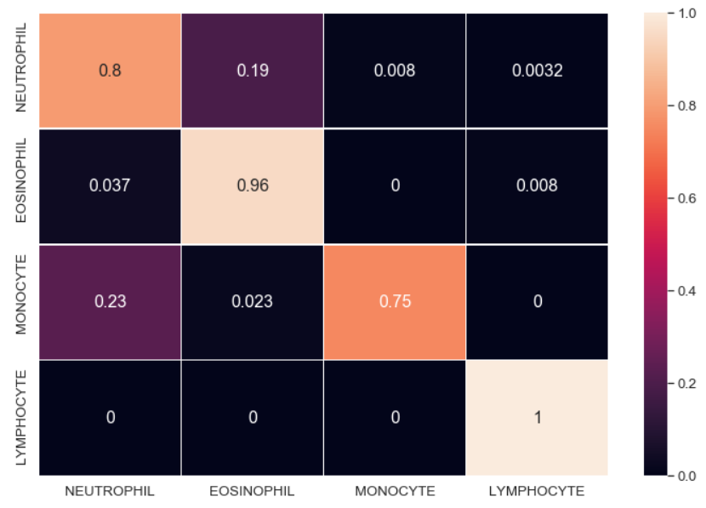
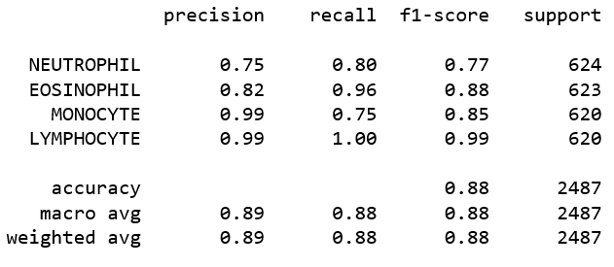
Demo
Classifier
White Blood Cell Keras Inception
https://www.kaggle.com/kartiksharma522/blood-cell-keras-inception/
Notes:
We can see here that the model sometimes misclassifies Neutrophils as Eosinophils and Monocytes as Neutrophils.
If we look back at the previous slide we can see why this may be as these are in fact quite similar with Lymphocytes being clearly distinguishable from the rest thus providing best performance.
Overall though the model’s performance is quite good considering the complexity of the task and other attempts I have reviewed.

Slide 26
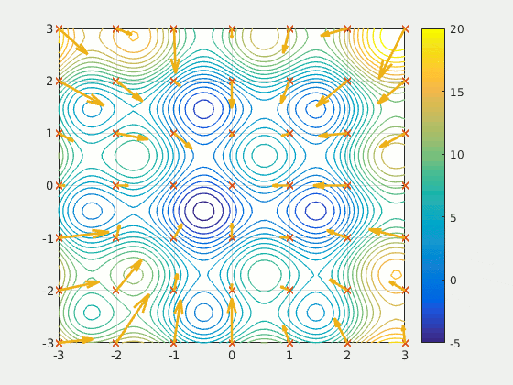
Demo
Particle Swarm Optimisation
Notes:
PSO is an optimisation algorithm that is part of Metaheuristics
Metaheuristics is a procedure in combinatorial optimisation and a sub-field of stochastic optimisation.
Essentially it uses a degree of randomness to search for an optimal solution to a complex problem, typically with a very large search space.
Referred to as black-box optimisers that use some kind of combination of hill-climbing and random search.
PSO
It resembles evolutionary algorithms to a certain extent with an important diﬀerence – there is no form of re-sampling to produce new candidates, instead the algorithm performs a directed mutation of each candidate based on its ﬁtness.
This means that the candidate population, or swarm, remains static throughout the procedure with only the individual values of each particles changing. The direction of the mutations is based upon the best known position in the space associated with the individual and the entire swarm, here with an addition of a neighbourhood.
For each dimension i velocity vi is updated based on a weighted sum of diﬀerences between the current value xi and values at personal x∗ i, local x+ i and global x! i best positions. The weights are real numbers between 0 and the value provided at initialisation for each of the elements.
Then, particle position is updated as ~x ←~x + ~v for each particle and at each iteration. Particle position ~x refers to all of its dimensions, i.e. ~x = hx1,x2,...,xni, a denotes the size of a jump each of the particles takes known as inertia weight. The procedure is repeated until an ideal solution is found or it runs out of time
Although Particle Swarm Optimisation is known to provide very good optimisation results it can suﬀer from premature convergence which aﬀects its performance and can lead to sub optimal solutions (Pant et al., 2009), particularly in high dimensional spaces (Jamian et al., 2014; Liu and Abraham, 2005). The algorithm should be therefore optimised to provide the best possible performance in given scenario by choosing the right inertia weight a and the weights given to each of the best solution elements, i.e. b, c and d.

Slide 27
Demo
Objective
Non-Targeted Black-Box Adversarial Attack
Variants
1: Without a Mask
2: With a Mask
3: With an Inverse Mask
Setup
Particle Swarm Optimisation
45 particles in 3 neighbourhoods (15, 15, 15)
Cost as Confidence when classified correctly, 0 if incorrectly
Hyperparameters pre-adjusted
30 iterations until completion
→ Jupyter Notebook

Slide 28
Review
1: Without a Mask
Space: 57,600 (100%)
Time: 5m6s
Found: 248
First: 17th iteration and distance 1,454,884
Best: 21st iteration and distance 1,368,705

Slide 29
Review
2: With a Mask
Space: 3,069 (5%)
Time: 1m55s
Found: 419
First: 18th iteration and distance 123,930
Best: 22nd iteration and distance 114,842

Slide 30
Review
3: With an Inverse Mask
Space: 54,531 (95%)
Time: 6m28s
Found: 1805
First: 14th iteration and distance 16,347,383
Best: 17th iteration and distance 13,561,355

Slide 31
Review
Explaining Adversarial Examples
Inverse Masked Unmasked Original

Slide 32
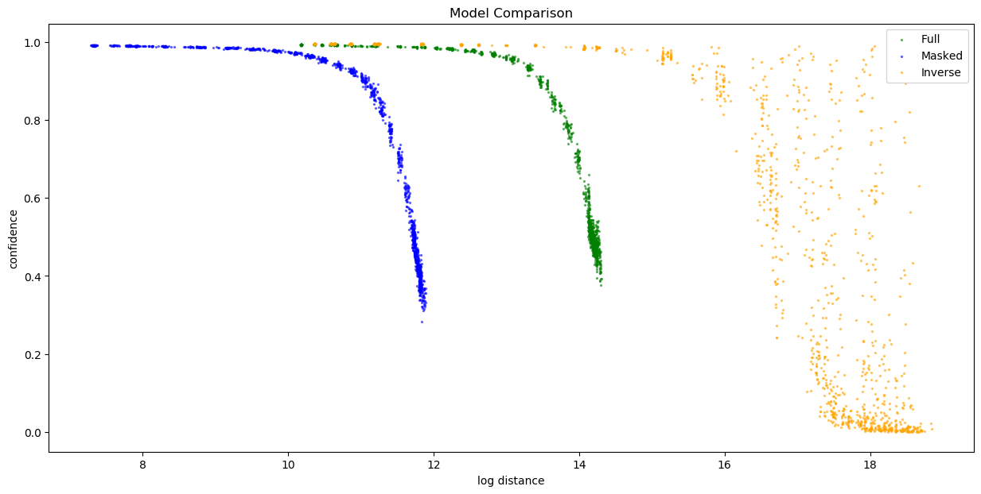
Further Research
Questions
What does this tell us about the model?
How can this be leveraged for adversarial training?
Can we use this information for detecting adversarial attacks?

Slide 33
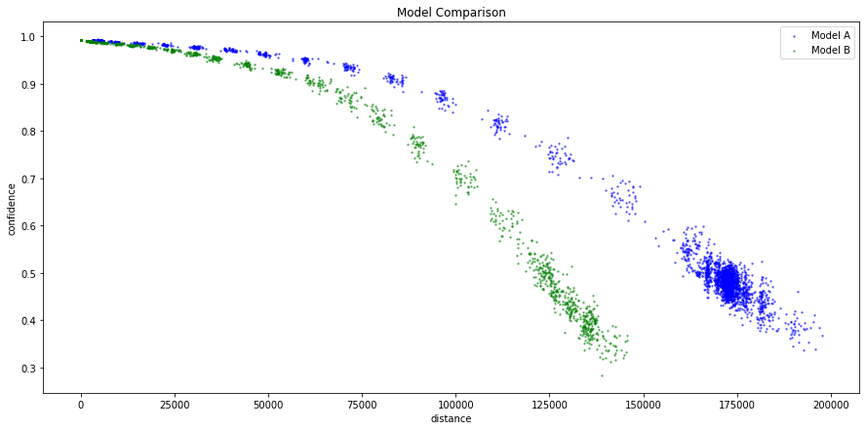
Further Research
Adversarial Robustness
Distance of Adversarial Attack as a Robustness Measure ?

Slide 34
Questions?

Slide 35
Thank You

