Slide 1
Safety in AI Systems: Verification of Deep Neural Networks
Guy Katz
LAIV Seminar
May $13$^{th}, $2020$

Slide 2
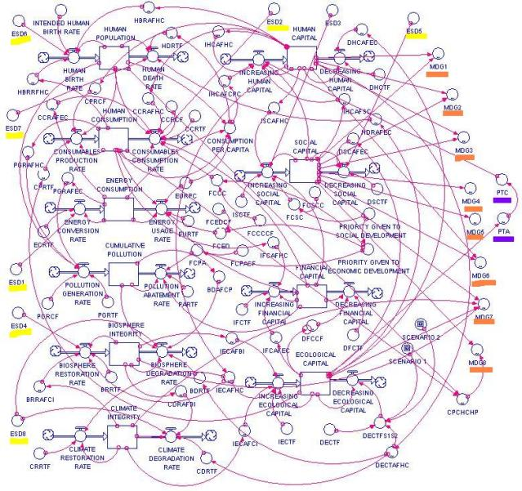
Programming by Machine Learning
How can we certify these systems?
Requirements
Training Algorithm
Artifact
Input/Output Pairs

Slide 3
When Things Go Wrong
Tesla model-s autopilot slams into a wall ($2017)$

Slide 4
Adversarial Inputs
Slight input perturbations cause misclassification
State-of-the-art networks are vulnerable
Goodfellow et al., $2015$
$$ε$$

Slide 5
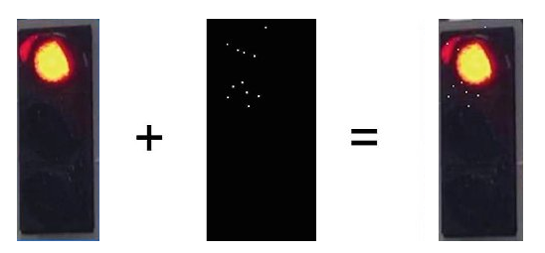
Adversarial Inputs (cnt’d)
Attacks exist in the real world
And attackers are getting better
How can we ensure robustness before deployment?
Traffic Light
$11$ White Pixels
Oven

Slide 6
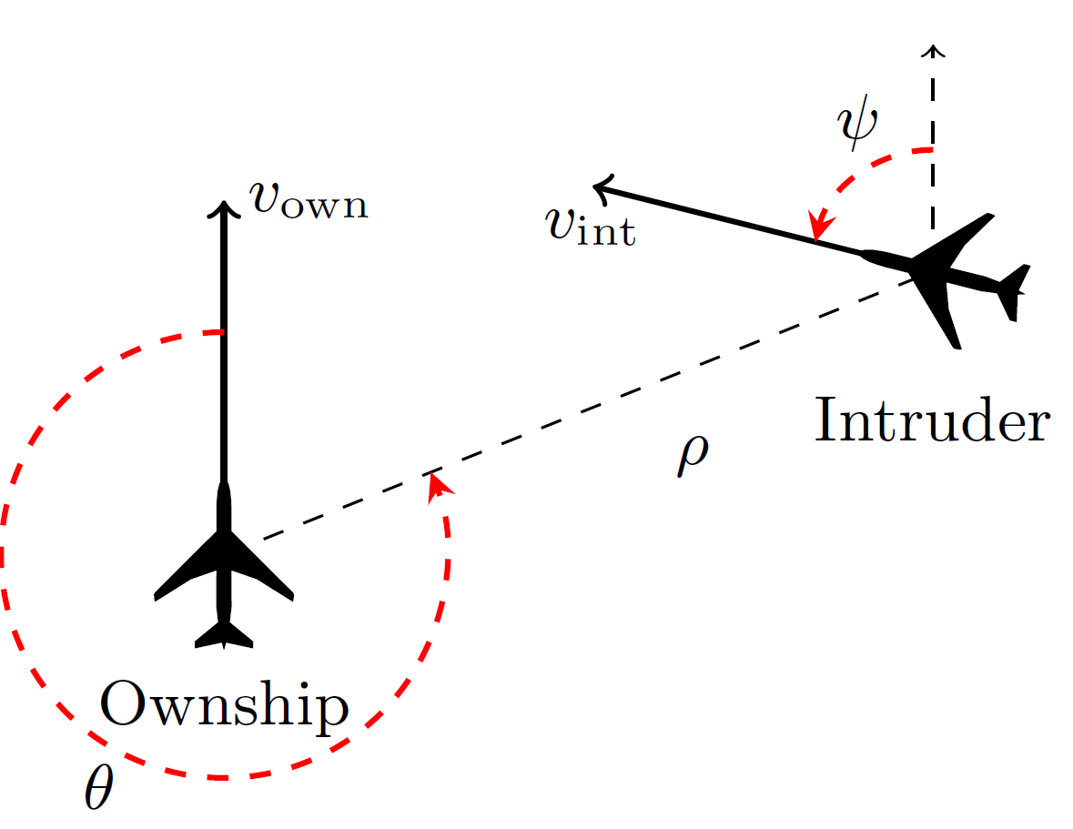
The ACAS Xu System
Airborne Collision-Avoidance System for drones
A new standard being developed by the FAA
Produce advisories:
Strong left (SL)
Weak left (L)
Strong right (SR)
Weak right (R)
Clear of conflict (COC)
FAA considering an implementation that uses $45$ deep neural networks
But wants to verify them!

Slide 7
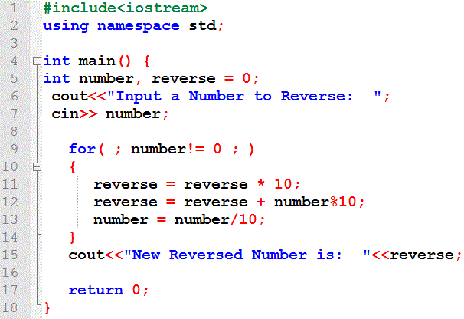
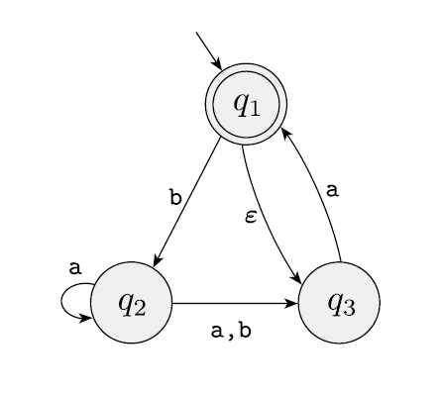
Formal Verification
Formally prove that a program is correct
Verification
+ Counter-Example

Slide 8
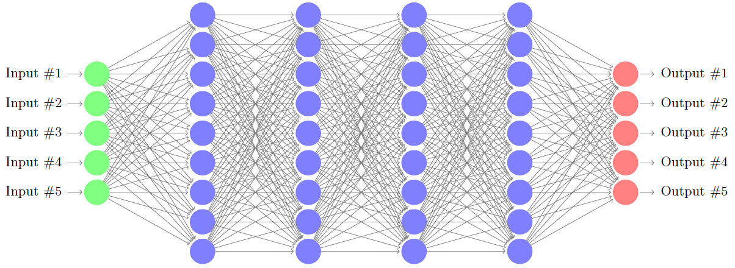
Verifying Neural Networks
Verification of neural networks: new field
$Q$ is the negation of the desired property
SAT: the discovered point is a counter example
UNSAT: property holds
Input Space
Output Space
$Q$
$P$

Slide 9
Verifying Neural Networks
Formally prove a property of a neural network
Or return a counter example
Possible applications:
Check robustness against adversarial examples
Formally verify safety-critical systems that incorporate neural networks
Extract properties of networks
Make networks more understandable to humans

Slide 10
Certifying ACAS Xu Networks
Neural networks generalize to previously-unseen inputs
Show that certain properties hold for all inputs
Examples:
If intruder is distant, advisory is always COC
If intruder is nearby on the left, advisory is always “strong right”
Crucial for increasing the level of confidence

Slide 11
Agenda
Neural Networks Overview
The Simplex Method
Reluplex
Evaluation on the ACAS Xu Networks
Conclusion

Slide 12
Agenda
Neural Networks Overview
The Simplex Method
Reluplex
Evaluation on the ACAS Xu Networks
Conclusion

Slide 13
Deep Neural Nets (DNNs)
Incomprehensible to humans
ACAS Xu networks: $8$ layers, $310$ nodes (x $45$)

Slide 14
Verifying Neural Networks
Does an input property imply an output property?
Intruder is distant $⇒$ Advisory is clear of conflict?
This problem is NP-complete in the size of the network
Verifying a network with $300$ nodes may require $2^{300}$ actions
This is often the case in verification
But many success stories exist!
Key point: worst-case does not usually happen in practice!

Slide 15
The Culprits: Activation Functions
Steps:
Weighted sum
Activation function
$$2$$
$$1$$
$$0$$
$$3$$
$$f(4)$$
$$2⋅1+0⋅3+(−1)⋅\left(−2\right)=4$$
$$−1$$
$$−2$$

Slide 16
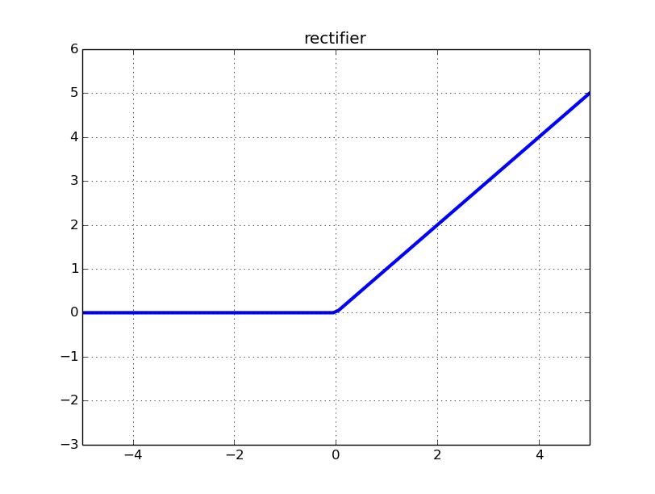
Rectified Linear Units (ReLUs)
ReLU($x$) = $max⁡(0,x)$
$x≥0$: active case, return $x$
$x<0:$ inactive case, return $0$
$$2$$
$$1$$
$$1$$
$$0$$
$$3$$
$$−2$$
$$0$$
$$4$$
$$1⋅1+\left(−2\right)⋅3+0⋅\left(−2\right)=−5$$
$$2⋅1+0⋅3+(−1)⋅\left(−2\right)=4$$
$$−1$$
$$−2$$
$$0$$

Slide 17
Case Splitting
A property: linear constraints on inputs and outputs
If the intruder is distant, advisory is COC
Without activation functions, network would be linear
Linear programs are easy to solve
Handling ReLUs: translate into a sequence of linear problems

Slide 18
Case Splitting (cnt’d)
Case splitting approach:
Fix each ReLU to a linear segment (active or inactive)
Solve the resulting linear problem
If property is violated for this configuration, stop
But if property holds, backtrack and try other option
State explosion: $300$ReLUs $→2^{300}$ checks
$$a+b+c=5, b>c$$
$$y=ReLU(x)$$
$$a+b+c=5, b>c$$
$$y=x, x≥0$$
$$a+b+c=5, b>c$$
$$y=0, x≤0$$

Slide 19
A SAT/SMT Based Approach
A way to mitigate this state explosion
Lazy approach: no case splitting in advance
ReLU constraints satisfied incrementally
Split only if we must
Conflict analysis to prune the search space
Scales to the ACAS Xu networks
An order of magnitude larger than previously possible

Slide 20
Agenda
Neural Networks Overview
The Simplex Method
Reluplex
Evaluation on the ACAS Xu Networks
Conclusion

Slide 21
Encoding Networks
No activation functions
Property being checked: It is possible that $x_{1}∈[0,1]$ and $x_{4}∈[0.5,1]$
$$x_{2}$$
$$1$$
$$1$$
$$x_{1}$$
$$x_{4}$$
$$−1$$
$$x_{3}$$
$$1$$

Slide 22
Encoding Networks (cnt’d)
Introduce equalities:
Set bounds: $x_{1}∈[0,1]$ $x_{4}∈\left[0.5,1\right]$ Hidden variables $x_{2},x_{3}$: unbounded
$$x_{2}$$
$$1$$
$$1$$
$x_{2}−x_{1}=0$ $x_{3}+x_{1}=0$ $x_{4}−x_{3}−x_{2}=0$
$x_{2}−x_{1}=x_{5}$ $x_{3}+x_{1}=x_{6}$ $x_{4}−x_{3}−x_{2}=x_{7}$
$x_{2}−x_{1}=0$ $x_{3}+x_{1}=0$ $x_{4}−x_{3}−x_{2}=0$
$$x_{1}$$
$$x_{4}$$
$$−1$$
$$x_{3}$$
$$1$$
Auxiliary variables: $x_{5},x_{6},x_{7}∈[0,0]$

Slide 23
The Simplex Method
Simplex: a method for solving linear equations + bounds
Efficient in practice
Sound and terminating
(but can’t handle ReLUs)

Slide 24
Executing Simplex
Update variable assignment
Always ensure equations hold
Gradually satisfy variable bounds
Possible steps:
Pivot steps: manipulate equations, isolate variables
Update steps: update variable assignment

Slide 25
Simplex: Example (cnt’d)
$$x_{5}=x_{2}−x_{1}$$
$$x_{5}=x_{4}−x_{1}−x_{3}−x_{7}$$
$$x_{5}=x_{4}−x_{1}−x_{3}−x_{7}$$
$$x_{1}=x_{4}−x_{3}−x_{5}−x_{7}$$
$$x_{6}=x_{3}+x_{1}$$
$$x_{6}=x_{4}−x_{5}−x_{7}$$
$$x_{7}=x_{4}−x_{3}−x_{2}$$
$$x_{7}=x_{4}−x_{3}−x_{2}$$
$$x_{2}=x_{4}−x_{3}−x_{7}$$
Lower Bound
$$0$$
$$0.5$$
$$0$$
$$0$$
$$0$$
Variable
$$x_{1}$$
$$x_{2}$$
$$x_{3}$$
$$x_{4}$$
$$x_{5}$$
$$x_{6}$$
$$x_{7}$$
Assignment
Upper Bound
$$1$$
$$1$$
$$0$$
$$0$$
$$0$$
Operation:
$$0$$
$$0.5$$
$$x_{4}≔x_{4}+0.5$$
$$0$$
$$x_{7}≔x_{7}−0.5$$
$$x_{5}≔x_{5}−0.5$$
Fail
$$0$$
$$0.5$$
$$0$$
$$0$$
$$0$$
$$0.5$$
$$0$$
$$0$$
$$0.5$$
$$0$$
$$0.5$$
$$0$$
$$0.5$$
$$0$$
$$0$$
$$0.5$$
$$0$$
$$0.5$$

Slide 26
Handling ReLUs with Simplex?
Check $4$ cases:
$x_{2}$ inactive, $x_{3}$ inactive: $\left(x_{1}<0, x_{2}=0\right)$ $∧$ $\left(−x_{1}<0,x_{3}=0\right)$
$x_{2}$ active, $x_{3}$ inactive: $(x_{1}≥0, x_{2}=x_{1})$ $∧$ $\left(−x_{1}<0,x_{3}=0\right)$
$x_{2}$ inactive, $x_{3}$ active: $\left(x_{1}<0, x_{2}=0\right)$ $∧$ $\left(−x_{1}≥0,x_{3}=−x_{1}\right)$
$x_{2}$ active, $x_{3}$ active: $(x_{1}≥0, x_{2}=x_{1})$ $∧$ $(−x_{1}≥0,x_{3}=−x_{1})$
$$x_{2}$$
$$1$$
$$1$$
$$x_{1}$$
$$x_{4}$$
$$−1$$
$$x_{3}$$
$$1$$

Slide 27
Agenda
Neural Networks Overview
The Simplex Method
Reluplex
Evaluation on the ACAS Xu Networks
Conclusion

Slide 28
Based on:
“Reluplex: An Efficient SMT Solver for Verifying
Deep Neural Networks”, in Proc. CAV $2017$
Joint work with Clark Barrett, David Dill, Kyle Julian and Mykel Kochenderfer Available on arXiv: $1702.01135$

Slide 29
ReLUs As Variable Pairs
Split ReLUs into:
A weighted sum variable
An activation function variable
Allow ReLU violations, fix them gradually
Similarly to out-of-bounds violations
Using pivot and update operations
ReLU
$$x_{2}^{w}$$
$$x_{2}$$
$$x_{2}^{a}$$
$$1$$
$$1$$
$$x_{1}$$
$$x_{4}$$
$$−1$$
ReLU
$$x_{3}^{w}$$
$$x_{3}^{a}$$
$$x_{3}$$
$$1$$

Slide 30
Encoding Networks
Introduce auxiliary variables: $x_{5}=x_{2}^{w}−x_{1}$ $x_{6}=x_{3}^{w}+x_{1}$ $x_{7}=x_{4}−x_{3}^{a}−x_{2}^{a}$
Bounds: $x_{1}∈[0,1]$, $x_{4}∈[0.5,1]$ $x_{5},x_{6},x_{7}∈\left[0,0\right]$
$w$ variables unbounded, $a$ variables non-negative
ReLU
$$x_{2}^{w}$$
$$x_{2}^{a}$$
$$1$$
$$1$$
$$x_{1}$$
$$x_{4}$$
ReLU
$$−1$$
$$x_{3}^{w}$$
$$x_{3}^{a}$$
$$1$$

Slide 31
Reluplex: Example
$$x_{1}=x_{2}^{w}−x_{5}$$
$$x_{5}=x_{2}^{w}−x_{1}$$
$$x_{5}=x_{2}^{w}−x_{1}$$
$$x_{6}=x_{3}^{w}+x_{1}$$
$$x_{6}=x_{2}^{w}+x_{3}^{w}−x_{5}$$
$$x_{6}=x_{2}^{w}+x_{3}^{w}−x_{5}$$
$$x_{3}^{w}=x_{5}+x_{6}{−x}_{2}^{w}$$
Lower Bound | Variable | Assignment | Upper Bound
$$0$$ | $$x_{1}$$ | $$0$$ | $$1$$
 | $$x_{2}^{w}$$ | $$0$$ | $$x_{2}^{b}$$
$$0$$ | $$x_{2}^{a}$$ | $$0$$ | $$x_{2}^{f}$$
 | $$x_{3}^{w}$$ | $$0$$ | $$x_{3}^{b}$$
$$0$$ | $$x_{3}^{a}$$ | $$0$$ | $$x_{3}^{f}$$
$$0.5$$ | $$x_{4}$$ | $$0$$ | $$1$$
$$0$$ | $$x_{5}$$ | $$0$$ | $$0$$
$$0$$ | $$x_{6}$$ | $$0$$ | $$0$$
$$0$$ | $$x_{7}$$ | $$0$$ | $$0$$
$$x_{7}=x_{4}−x_{3}^{a}−x_{2}^{a}$$
$$x_{7}=x_{4}−x_{3}^{a}−x_{2}^{a}$$
$$x_{2}^{a}=x_{4}−x_{3}^{a}−x_{7}$$
$$0$$
$$0.5$$
$$0$$
$$0.5$$
Operation:
$$0$$
$$0.5$$
$$x_{5}≔x_{5}−0.5$$
$$x_{6}≔x_{6}−0.5$$
Success
$$x_{4}≔x_{4}+0.5$$
$$x_{7}≔x_{7}−0.5$$
$$x_{2}^{w}≔x_{2}^{w}+0.5$$
$$0$$
$$−0.5$$
$$0$$
$$0.5$$
$$0$$
$$0.5$$
$$0.5$$
$$0$$
$$0.5$$
$$0.5$$
$$0$$
$$0.5$$
$$0.5$$

Slide 32
The Assignment is a Solution
Property being checked: Is it possible that $x_{1}∈[0,1]$ and $x_{4}∈[0.5,1]$?
ReLU
ReLU
$$0.5$$
$$0.5$$
$$0.5$$
$$0.5$$
$$1$$
$$1$$
$$1$$
$$1$$
$$0.5$$
$$0.5$$
$$0.5$$
$$0.5$$
ReLU
ReLU
$$−1$$
$$−1$$
$$−0.5$$
$$−0.5$$
$$0$$
$$0$$
$$1$$
$$1$$

Slide 33
Soundness & Termination
Soundness is straightforward
Can we always find a solution using pivots and updates?
No: sometimes get into a loop
May have to split on ReLU variables
Do so lazily
In practice, about $10\%$ of the ReLUs

Slide 34
Reluplex: Efficient Implementation
Deduction steps: bound tightening
Deriving tighter lower/upper bounds can eliminate ReLUs
Use a Satisfiability Modulo Theories (SMT) framework
Efficiently manage case splits and bound tightening
Conflict analysis, CDCL
Use floating point arithmetic
Put bounds on round-off errors
For more details, see paper
$$x=y+z \\ x≥−2 \\ y≥1 \\ z≥1$$
$$x≥2$$

Slide 35
Next Generation: Marabou
Followup work (CAV $2019$)
Engineering improvements
Multiple input formats, including TensorFlow
Parallelism: divide and conquer
Network level reasoning
New simplex solver

Slide 36
Agenda
Neural Networks Overview
The Simplex Method
Reluplex
Evaluation on the ACAS Xu Networks
Conclusion

Slide 37
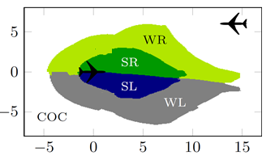
Properties of Interest
No unnecessary turning advisories
Alerting regions are consistent
Strong alerts do not appear when vertical separation is large

Slide 38
ACAS Xu: Example $1$
“If the intruder is near and approaching from the left, the network advises strong right”
Distance: $12000≤ρ≤62000$
Angle to intruder: $0.2≤θ≤0.4$
…
Proof time: $01$:$29$:$29$ (using $4$ machines)
Notes:
Property 5 in the paper

Slide 39
ACAS Xu: Example 2
“If vertical separation is large and the previous advisory is weak left, the network advises COC or weak left”
Distance: $0≤ρ≤60760$
Time to loss of vertical separation: $τ=100$
…
Time to find counter example: $11$:$08$:$22$ (using $1$ machine)
Notes:
Property 8 in the paper

Slide 40
Local Adversarial Robustness
Local robustness at $x$: how far from $x$ is the first adversarial example?
 | $$δ=0.1$$ | $$δ=0.075$$ | $$δ=0.05$$ | $$δ=0.025$$ | $$δ=0.01$$ | Avg. Time
$$1$$ | vulnerable | vulnerable | vulnerable | robust | robust | $$00\text{:}03\text{:}32$$
$$2$$ | robust | robust | robust | robust | robust | $$00\text{:}24\text{:}38$$
$$3$$ | robust | robust | robust | robust | robust | $$00\text{:}04\text{:}50$$
$$4$$ | vulnerable | vulnerable | vulnerable | robust | robust | $$00\text{:}09\text{:}22$$
$$5$$ | robust | robust | robust | robust | robust | $$0\text{1}\text{:}0\text{8}\text{:}12$$
Notes:
Property 10 in the paper

Slide 41
Global Adversarial Robustness
Local robustness: check for fixed $x$
Global robustness: checked for all inputs simultaneously
$$x_{1}$$
$$x_{2}$$
Notes:
Property 10 in the paper

Slide 42
Global Adversarial Robustness
Inputs $x_{1},x_{2}$ are labeled as $ℓ$ with confidence $p_{1},p_{2}$ $∀x_{1},x_{2}.$ $∥x_{1}−x_{2}∥ ≤δ⇒| p_{1}−p_{2} |≤ε$
Checked for all inputs simultaneously
Difficult and slow
Double the network size
Large input domain
Notes:
Property 10 in the paper

Slide 43
Agenda
Neural Networks Overview
The Simplex Method
Reluplex
Evaluation on the ACAS Xu Networks
Conclusion

Slide 44
Conclusion
Neural networks as controllers for safety critical systems
Urgent need for techniques to reason about them
SMT approach: laziness, deductions, conflict analysis

Slide 45
Next Steps
Better scalability
More advanced SMT and Linear Programming techniques
Network-level reasoning
Abstract interpretation (Gehr et al., $2018$)
Symbolic intervals (Wang et al., $2018$)
Add local searches prune the search space (Dutta et al., $2018$)
Abstraction techniques, parallelism
Verifying properties of systems with network controllers

Slide 46
Questions
Thank You!

